Slide 1
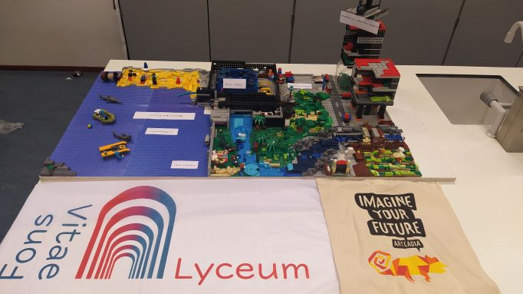
CITY OF THE FUTURE

